Slide 1
Carbon Emissions from Staff Commuting
Analysis of University Staff Commuting Patterns and their Environmental Impact
Presented by: Ayokunle James OLAGUNJU
Date: 25th June 2024

Slide 2
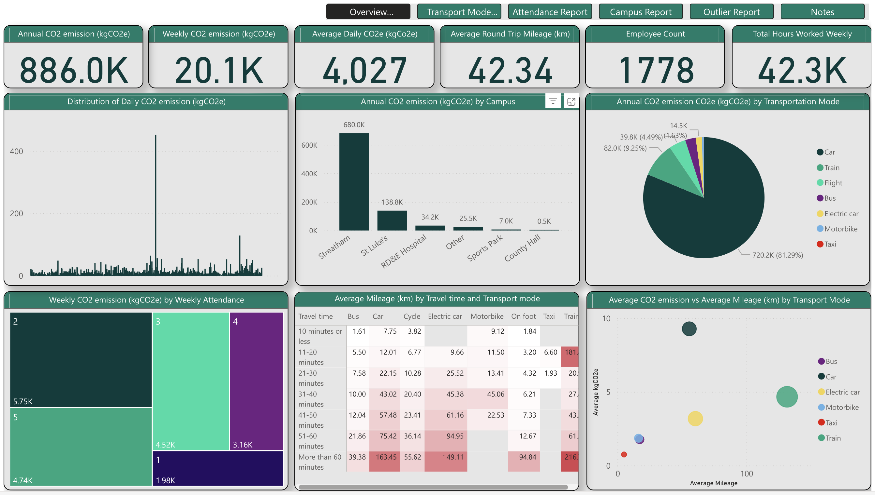

Emissions Overview
886,035 kgCO2e generated from 1,778 staff commuting to work in the 2023 academic year
Abnormal spikes in distribution of daily CO2e
Irregular relationship between travel time and transport mode

Slide 3
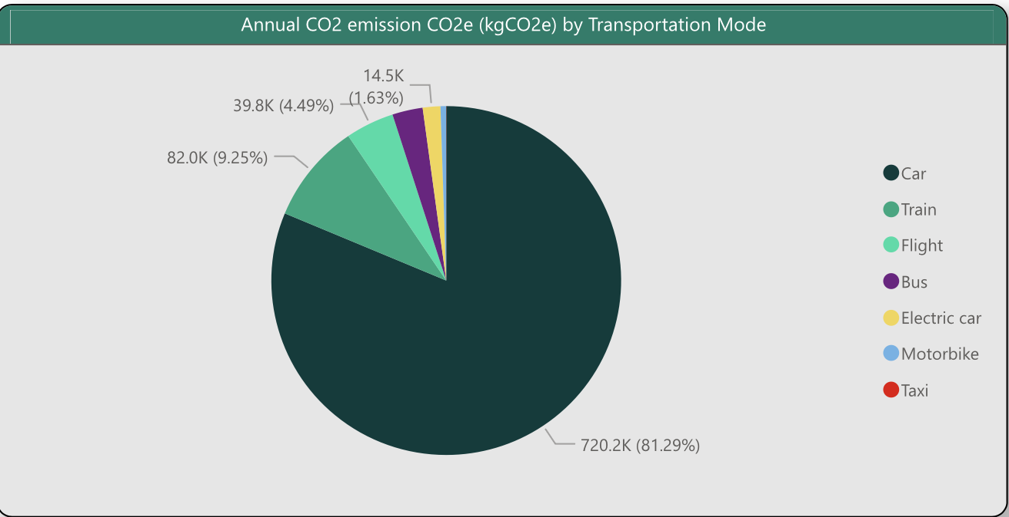
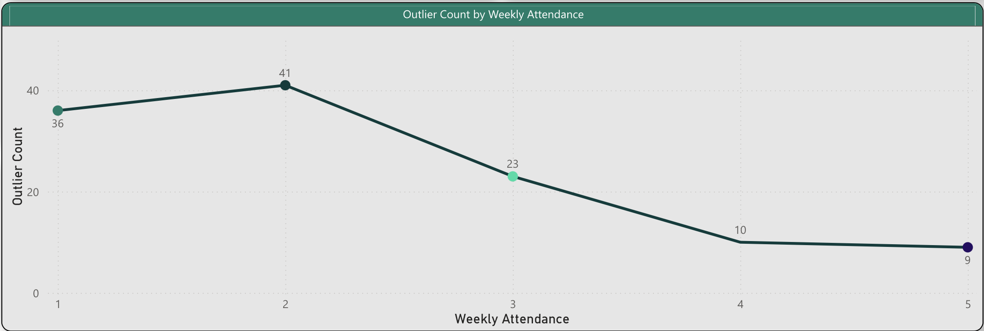
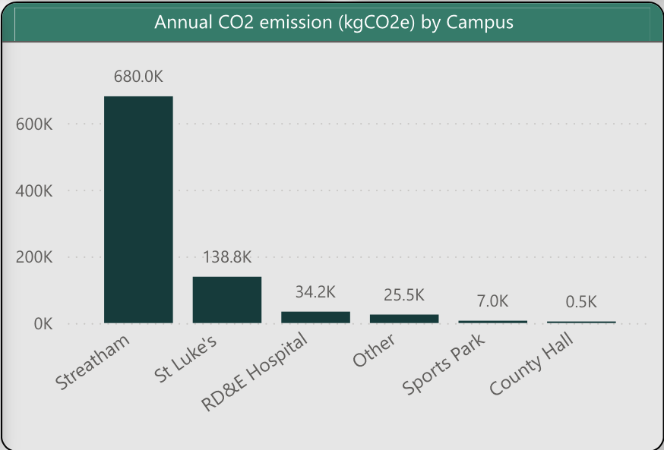
Key Findings & Trends
Car commuting accounts for 81% of total emissions
34% of outliers fall within the category of staff who commute twice a week
Streatham Campus staff have the highest contribution to emissions with 680k kgCO2e per academic year.

Slide 4





Recommendations
Remote Working
On-Campus Housing
Carbon-Efficient Transport Modes
Car Sharing
Data Quality
Increasing incentives for remote work and virtual meetings to reduce commuting needs, especially for Streatham campus staff.
Providing on-campus housing for staff to reduce commute distances and emissions.
Incentivizing carbon-efficient modes of transport like public transport bus, electric cars, and trains.
Additional facilities e.g., racks, Salary Sacrifice, EV chargers
Encouraging car-sharing to reduce single occupancy car commutes and lower emissions
Improving data quality through validation checks to enhance insights on carbon emissions.

Slide 5
Thank You.

